Slide 1

Disk structure

Slide 2

Disk structure
Disks provide the bulk of secondary storage for modern computer systems.
A hard disk stores and retrieves digital data using magnetic storage
Hard Disk Pack consist of more than one disk.

Slide 3
Disk structure
How Data is Stored in a Hard Disk ?
● Data is stored in Disk in form of tracks and sectors.
● Disk surface is divided in to tracks.
● Track is further divided in to sectors.
● Sector is the addressable unit in disk

Slide 4
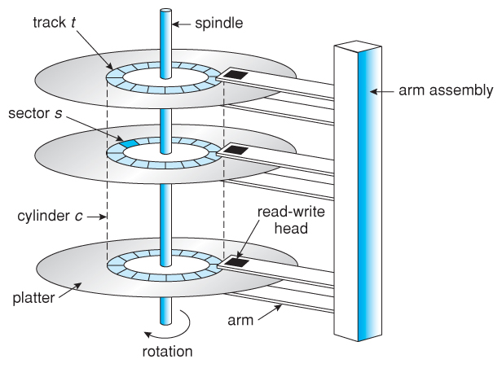
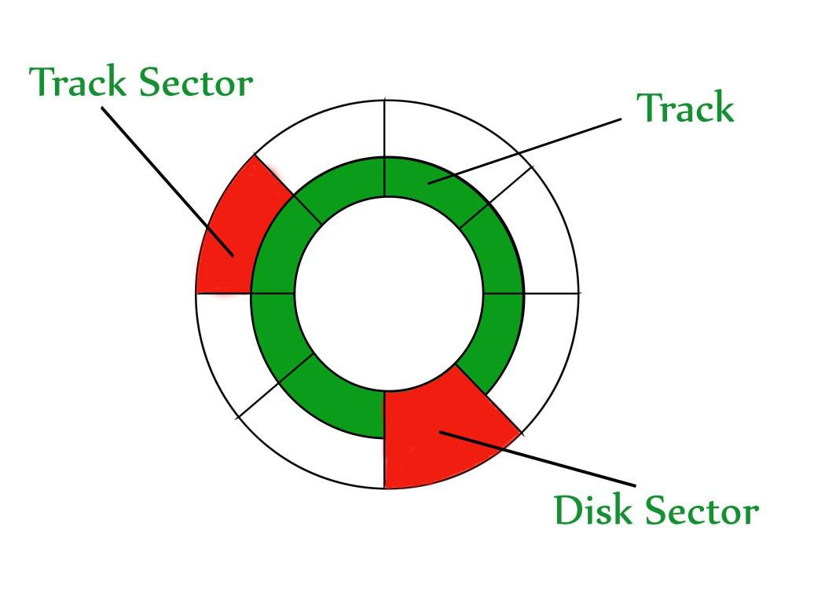
Disk structure

Slide 5
Disk structure
Disk surface divided into tracks ● A read/write head positioned just above the disk surface ● Information stored by magnetic recording on the track under read/write head

Slide 6
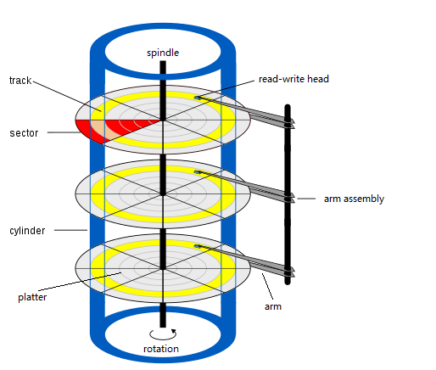

Slide 7
Disk structure
Disk controller ● A disk controller is a hardware component that manages data transfer between a computer's central processing unit (CPU) and a storage device like a hard drive or SSD. It acts as an intermediary, translating the operating system's requests into commands the drive can understand, and handling tasks like reading, writing, and error correction
Cylinder
● The same numbered tracks on all the disk surfaces
● Each track contains between 8 to 32 sectors
Sector
● Smallest unit of information that can be read from/written into disk
● Range from 32 bytes to 4096 bytes

Slide 8
Disk Scheduling
For the disk drives, OS responsibility is to handle disk drive efficiently that means having a fast access time and disk bandwidth.
The access time has two major components . The seek time is the time for the disk arm to move the heads to the cylinder containing the desired sector.
The rotational latency is the additional time waiting for the disk to rotate the desired sector to the disk head.
The disk bandwidth is the total number of bytes transferred, divided by the total time between the first request for service and the completion of the last transfer.
We can improve both the access time and the bandwidth by scheduling the servicing of disk I/O requests in a good order.

Slide 9
Disk Scheduling
When a process needs I/O from or to the disk, the process issues a system call to the operating system.
The system call indicates whether
The operation is input (read) or output (write),
What the disk address for the transfer is (the location in the disk from where data is to be read or to where data is to be written),
What the memory address for the transfer is (the location in the main memory from where data is to be moved to the disk or to where data is moved from the disk) and
What the number of bytes to be transferred is.

Slide 10
Disk Scheduling
If the desired disk drive and controller are available, the request is serviced immediately.
If the disk drive or controller is busy, the request is placed in the queue of pending requests.
The operating system services the requests one after the other.
When one request is completed, the operating system chooses which pending request to service next.
How does the operating system make this choice?
This choice is done in different ways using different algorithms called the disk scheduling algorithms.

Slide 11
FCFS Scheduling
Simplest form of disk scheduling is, the first-come, first-served (FCFS) algorithm.
Consider, for example, a disk queue with requests for I/O to blocks on cylinders in that order.
If the disk head is initially at cylinder 53, it will first move from 53 to 98, then to 183, 37, 122, 14, 124, 65, and finally to 67, for a total head movement of 640 cylinders

Slide 12
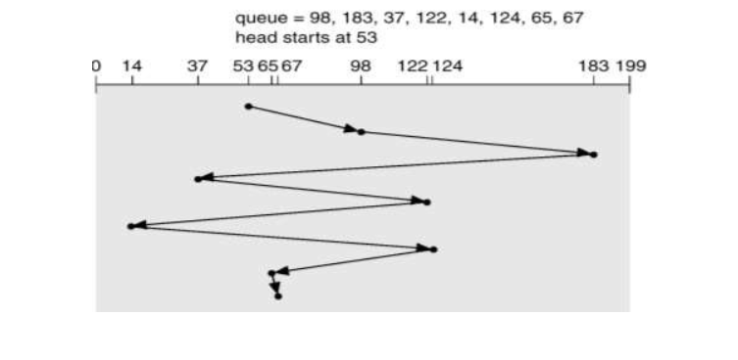
FCFS Scheduling

Slide 13
SSTF (Shortest Seek Time First) Scheduling
SSTF algorithm selects the request with the minimum seek time from the current head position. Since seek time increases with the number of cylinders traversed by the head

Slide 14
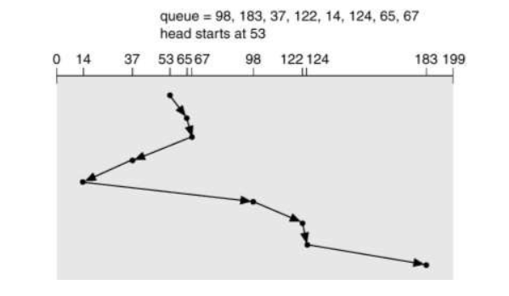
SSTF Scheduling

Slide 15
SSTF Scheduling
The closest request to the initial head position (53) is at cylinder 65. Once we are at cylinder 65, the next closest request is at cylinder 67.
From there, the request at cylinder 37 is closer than 98, so 37 is served next. Continuing, we service the request at cylinder 14, then 98, 122, 124, and finally 183 . This scheduling method results in a total head movement of only 236 cylinders

Slide 16
SCAN Scheduling
In the SCAN algorithm, the disk arm starts at one end of the disk, and moves toward the other end, servicing requests as it reaches each cylinder, until it gets to the other end of the disk.
At the other end, the direction of head movement is reversed, and servicing continues. The head continuously scans back and forth across the disk.
If a request arrives in the queue just in front of the head, it will be serviced almost immediately; a request arriving just behind the head will have to wait until the arm moves to the end of the disk, reverses direction, and comes back.
The SCAN algorithm is sometimes called the elevator algorithm, since the disk arm behaves just like an elevator in a building, first servicing all the requests going up, and then reversing to service requests the other way.

Slide 17
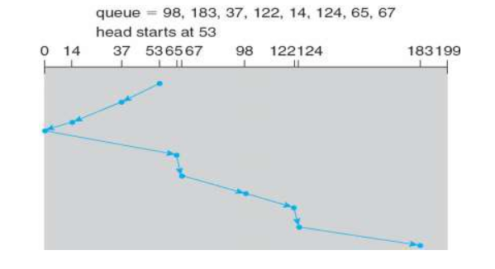
SCAN Scheduling
In the SCAN disk scheduling algorithm (also known as the Elevator algorithm), the disk head moves all the way to the absolute end of the disk (either the maximum or minimum cylinder, depending on the initial direction) before reversing its direction

Slide 18
C-SCAN Scheduling
C-SCAN moves the head from one end of the disk to the other, servicing requests along the way. When the head reaches the other end, however, it immediately returns to the beginning of the disk, without servicing any requests on the return trip .

Slide 19
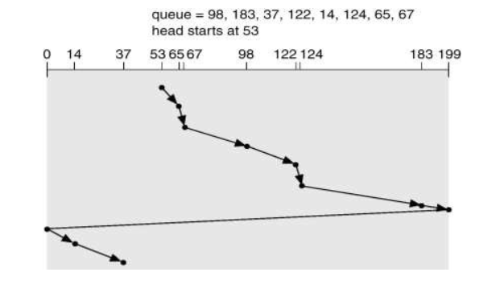
C-SCAN Scheduling

Slide 20
Disk Management
Disk Formatting
New magnetic disk is a blank slate: They are just platters of a magnetic record material.
Before a disk can store data, it must be divided into sectors that the disk controller can read and write. This process is called low-level formatting
Low-level formatting fills the disk with a special data structure for each sector.
The data structure for a sector typically consists of a header, a data area (usually 512 bytes in size), and a trailer.
The header and trailer contain information used by the disk controller, such as a sector number and an error-correcting code (ECC).

Slide 21
Disk Management
Disk Formatting
Steps and concepts
Low-level formatting: This is the initial physical preparation of the disk, creating tracks and sectors on the magnetic platter. This step is often done during manufacturing and is usually not a user-level operation anymore.
Partitioning: This is the process of dividing a disk into one or more logical sections called partitions. You can create one or more partitions on a single physical disk to organize data.
High-level formatting: This is the user-level process of creating a file system on a partition, which the operating system uses to manage files. It erases the disk's contents and sets up a file system structure (like NTFS or FAT32).
File systems: It dictates how data is structured and accessed, typically using a hierarchical directory system (folders and subfolders), and provides a way to retrieve and control files. Common examples include NTFS (Windows), ext4 (Linux), and FAT32 (cross-platform).

Slide 22
When the computer is powered on, the system firmware (like BIOS or Unified Extensible Firmware Interface[UEFI]) executes.
It performs the Power-On Self-Test (POST) to check that essential hardware components are present and functioning correctly.
After POST, the firmware looks for a boot device (like a hard drive).
It then loads the first-stage bootloader, a small program that resides in the firmware's read-only memory or on a boot sector, into the system's main memory (RAM).
The first-stage bootloader finds and loads a more sophisticated bootloader into RAM.
This bootloader's main task is to locate the operating system kernel on the storage device and load it into memory.
Once the kernel is loaded, control is transferred to it, and the OS bootstrapping process transitions from the bootloader to the kernel.
The kernel identifies, configures, and initializes all the system's hardware and devices, including setting up device drivers.

Slide 23
Disk Management
Boot Block
For a computer to start running-for instance, when it is powered up or rebooted-it needs to have an initial program to run.
For most computers, the bootstrap is stored in read-only memory (ROM). This location is convenient, because ROM needs no initialization and is at a fixed location that the processor can start executing when powered up or reset. And, since ROM is read only, it cannot be infected by a computer virus.
The problem is that changing this bootstrap code requires changing the ROM hardware chips. For this reason, most systems store a tiny bootstrap loader program in the boot ROM, whose only job is to bring in a full bootstrap program from disk. The full bootstrap program can be changed easily: A new version is simply written onto the disk.
The full bootstrap program is stored in a partition called the boot blocks, at a fixed location on the disk. A disk that has a boot partition is called a boot disk or system disk

Slide 24
Disk Management
Bad Blocks
Physical or logical corruption: A bad block is a sector (or group of sectors) on a storage device like a hard drive that is either physically damaged or has a logical error.
Unusable: It cannot be reliably used to store or read data.
Commonly called a "bad sector": The terms "bad block" and "bad sector" are often used interchangeably, though a block can be a group of sectors.

Slide 25
Disk Management
Sector sparing or forwarding is an operating system (OS) and disk controller technique for handling bad sectors by logically replacing a defective sector with a pre-allocated spare sector.
When a bad sector is detected, its data is copied to a spare sector, and the original bad sector is marked as unusable
This method is a type of bad-block management that provides a degree of fault tolerance by preserving data on the disk.

